Slide 1
SEARCHING IN MORE COMPLEX ENVIRONMENTS
Main reference:
Chapters 4 of Russell, S., & Norvig, P. (2016). Artificial intelligence: a modern approach.

Slide 2











Previous searching algorithms requires
Assumptions of the environment:
Observable
Discrete
Deterministic

Slide 3



LOCAL SEARCH – SEARCHING FOR GOAL STATES

Slide 4
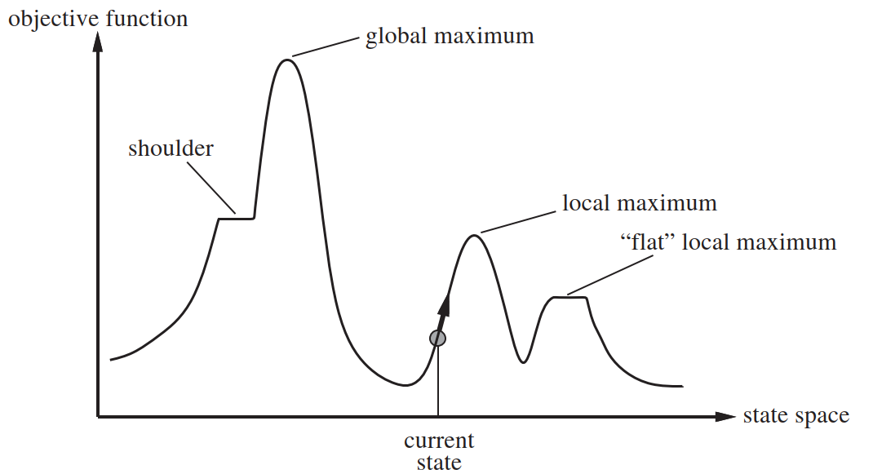












State space landscape
Optimal algorithms:
Source: (Russell, 2016)

Slide 5




Local search
Uses only one current node and its neighbors

Slide 6
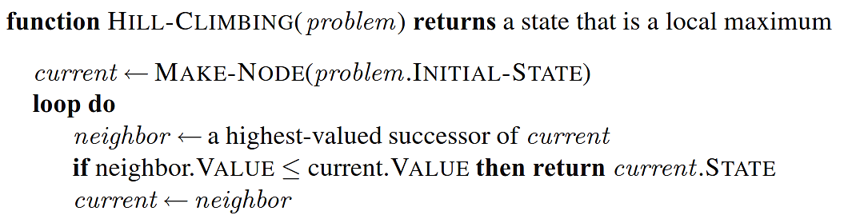




Hill-climbing search
Source: (Russell, 2016)

Slide 7
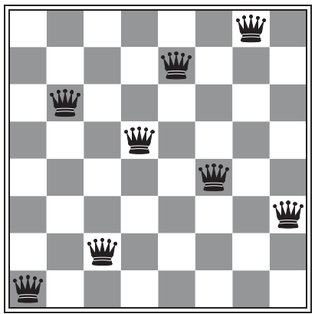







Demo
8-queen problem: a layout problem
State: 8 queens’ position
Successor of a state: a new state by
Cost function h(): number of pairs of queens that
Global minimum:
Image: (Russell, 2016)

Slide 8
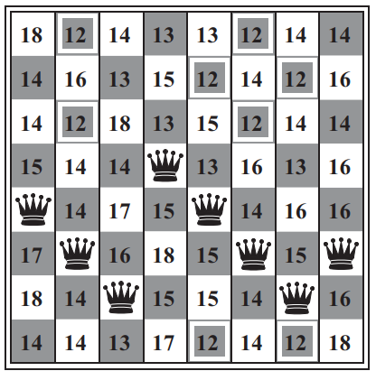







Image: (Russell, 2016)

Slide 9




Image: (Russell, 2016)

Slide 10






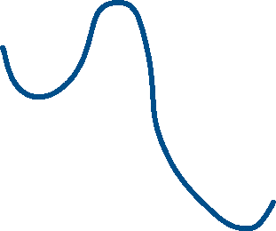

A local minimum
Image: (Russell, 2016)

Slide 11










Issues of hill-climbing search

Slide 12
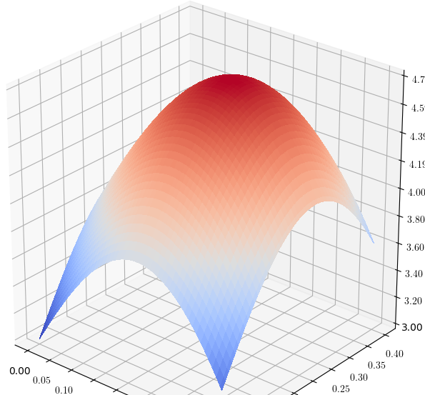








Issue 1: Too many successors
➔ Stochastic hill climbing:

Slide 13

Issue 2: Hill-climbing offen gets stuck at
+ Local maxima
+ Plateaux
Source: (Russell, 2016)

Slide 14

To overcome plateaux
Allow sideways moves:
Note:

Slide 15









Sideways moves in hill-climbing algorithm

Slide 16


For the 8-queens problem:
+ With no sideways moves:
+ With sideways moves:

Slide 17



To overcome local optima
Method 1: Random-restart hill climbing:

Slide 18







To overcome local optima
Method 2: Local beam search
Instead of trying k random searches sequentially, do them simultaneously. ➔ NOTE:
Local beam search: not just simultaneously, ➔

Slide 19






























Slide 20




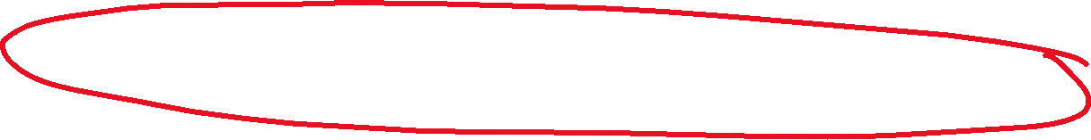








Slide 21








An improvement of local beam search
Stochastic beam search: combines Local beam search and Stochastic hill climbing.

Slide 22
To overcome local optima
Method 3: Simulated annealing
Annealing: harden metals by heating them, then gradually cooling them ➔ Material will reach a low-enery crystalline state (goal).
Downhill-climbing:

Slide 23
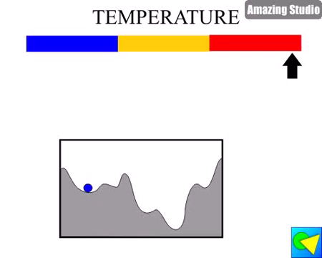
To overcome local optima
Method 3: Simulated annealing
Animation: Wintempla Selo

Slide 24
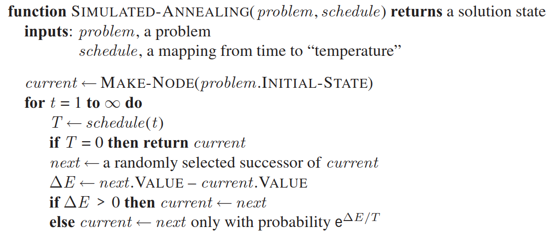





Simulated annealing algorithm
Source: (Russell, 2016)

